Slide 1

Zen Studio
AI-powered demo creation from any transcript
Paste a URL and a script. Zen Studio drives your app, narrates it,
and hands you a finished, verified product demo.

Slide 2
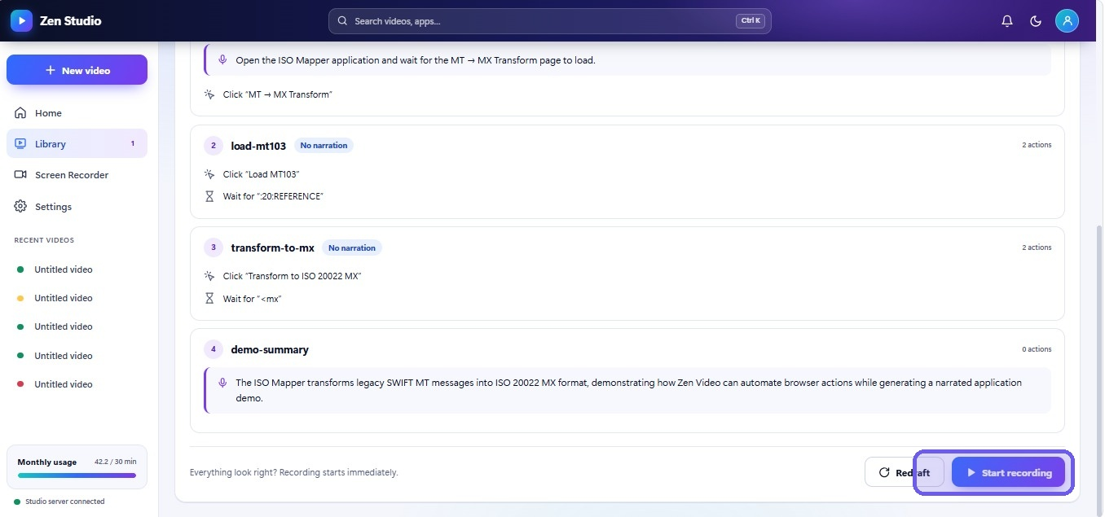
THE PROBLEM
Product demos don't scale
Every new feature, every prospect, every onboarding flow needs its own walkthrough — and today, a human has to make each one by hand.
1
Hours, not minutes
Recording, narrating, and re-cutting one clean demo video is most of a day's work.
2
One demo, one use-case
A generic walkthrough never speaks to the specific flow a buyer or new hire actually needs.
3
Stale the moment the UI ships
Every release quietly breaks the last recording — and nobody notices until a customer does.
A real Zen Studio build: every step reviewed before anything records.
Zen Studio
2

Slide 3
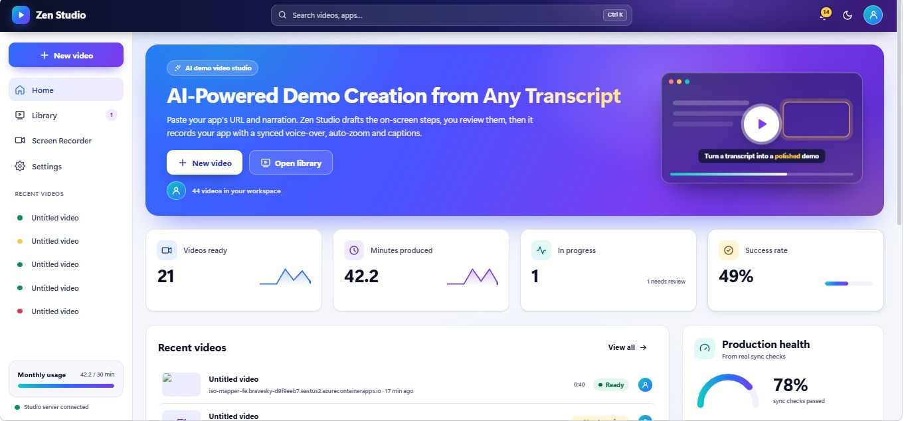
THE SOLUTION
Paste a URL and a script.
Get a narrated demo.
Zen Studio drafts the on-screen steps with AI, you approve them in one click, and it records your real app with a synced voice-over, auto-zoom, and captions — unattended.
Script
Review
Narration
Recording
Render
Sync check
Zen Studio
3

Slide 4
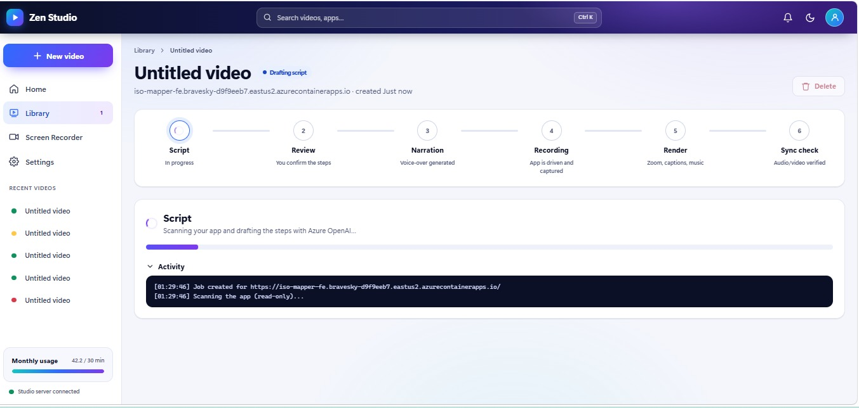
HOW IT WORKS
Six stages, fully automated
You only touch stage 2 — a one-click approval. Everything else runs on its own.
Zen Studio
4

Slide 5
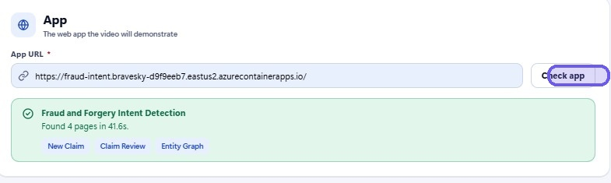
STEP 1 OF 6
Point it at your app
Paste any URL. Zen Studio crawls the live app and discovers every reachable page in under a minute — no manual sitemap, no setup.
“Found 4 pages in 41.6s” — discovered automatically.
Zen Studio
5

Slide 6
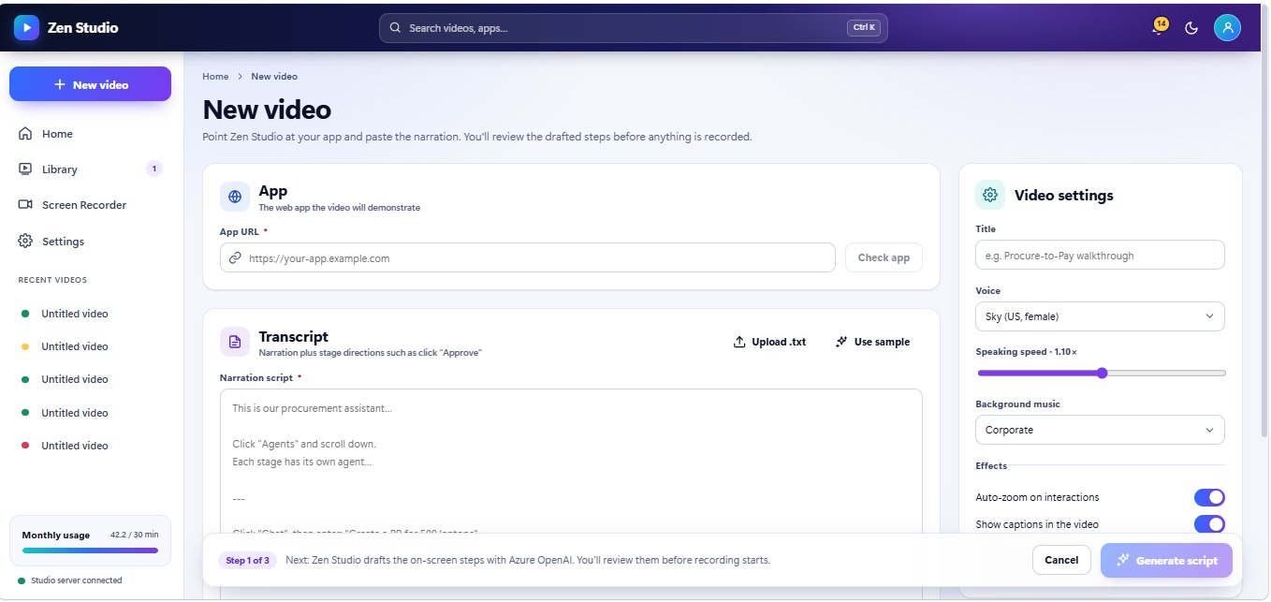
STEP 2 OF 6
Write narration,
not code
Plain-English narration doubles as the stage direction. “Click Agents and scroll down” is both the voice-over script and the action list — no automation syntax to learn.
Zen Studio
6

Slide 7
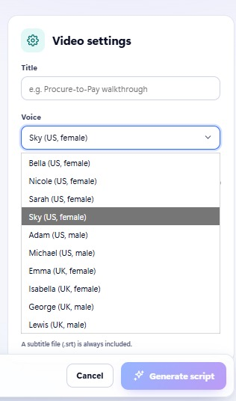
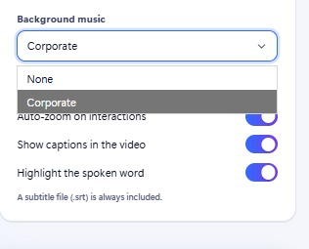
STEP 3 OF 6
Make it sound —
and look — right
Ten natural voices, adjustable speaking speed, background music, auto-zoom on every interaction, burned-in captions — every demo matches your brand, not a default.
Zen Studio
7

Slide 8
STEP 4 OF 6
AI drafts the steps,
you approve
Every click, wait, and scroll is drafted up front and shown in plain language. Redraft anything that's off — nothing records until you say go.
Zen Studio
8

Slide 9
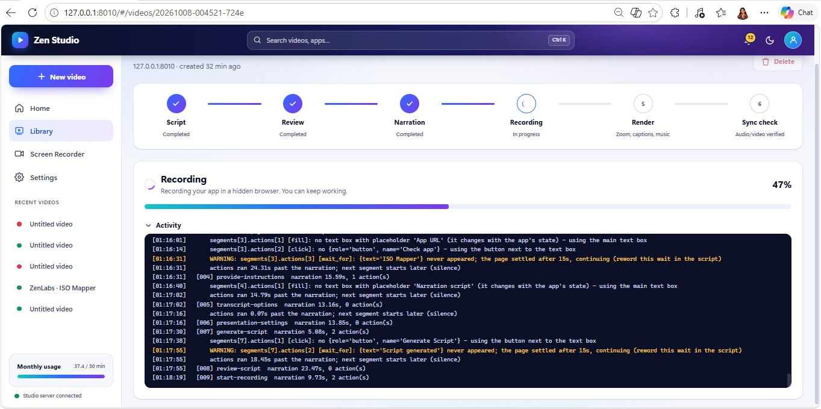
STEP 5 OF 6
Recording — resilient
by design
The app runs in a hidden browser while you keep working. If a step's button hasn't appeared yet, Zen Studio waits, re-reads the live page, and keeps going instead of simply stopping.
Zen Studio
9

Slide 10
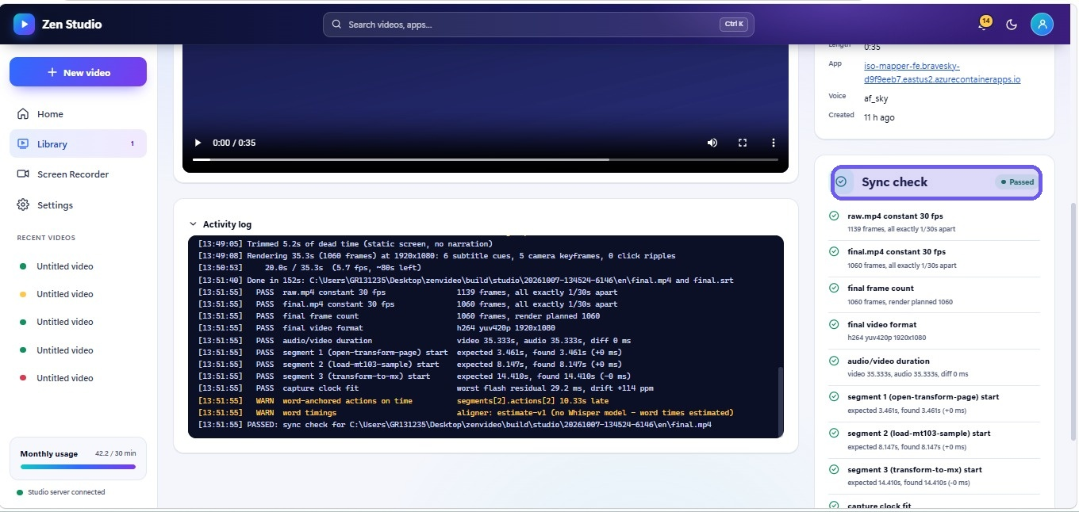
STEP 6 OF 6
Verified to
the millisecond
Every render runs an automatic sync check — frame counts, audio/video duration, and every segment's start time, measured against what actually happened on screen.
Zen Studio
10

Slide 11
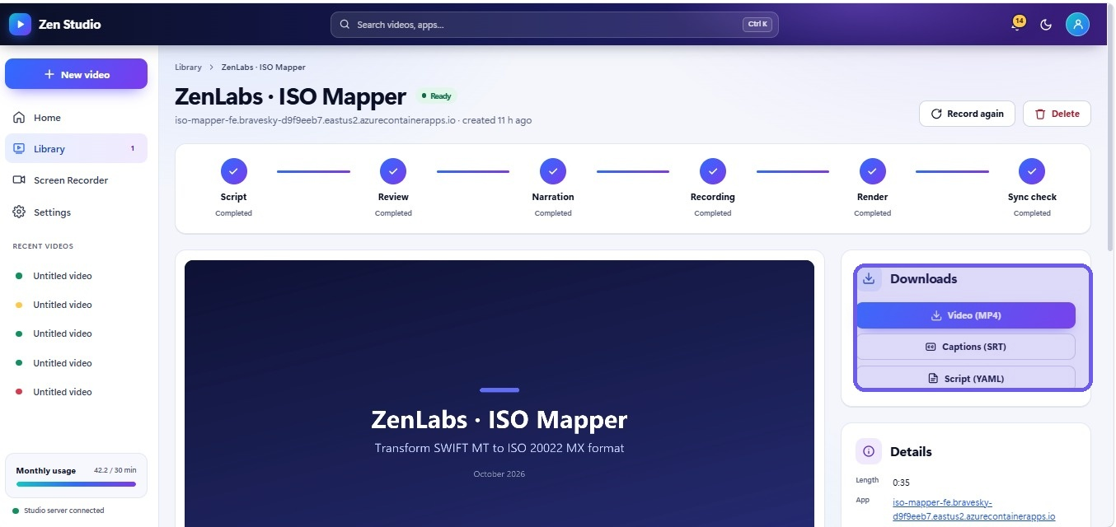
THE OUTPUT
Every demo ships complete
Not just a video — an MP4, burned-in or sidecar captions (.srt), and the full script (.yaml) for anyone who wants to edit and re-record it later.
Zen Studio
11

Slide 12
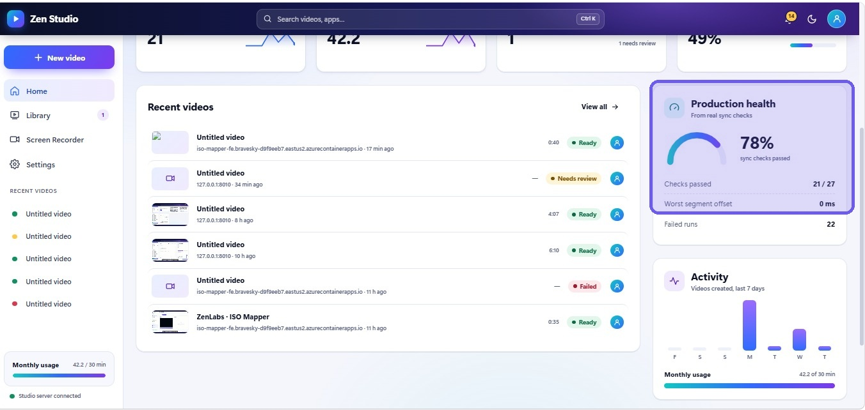
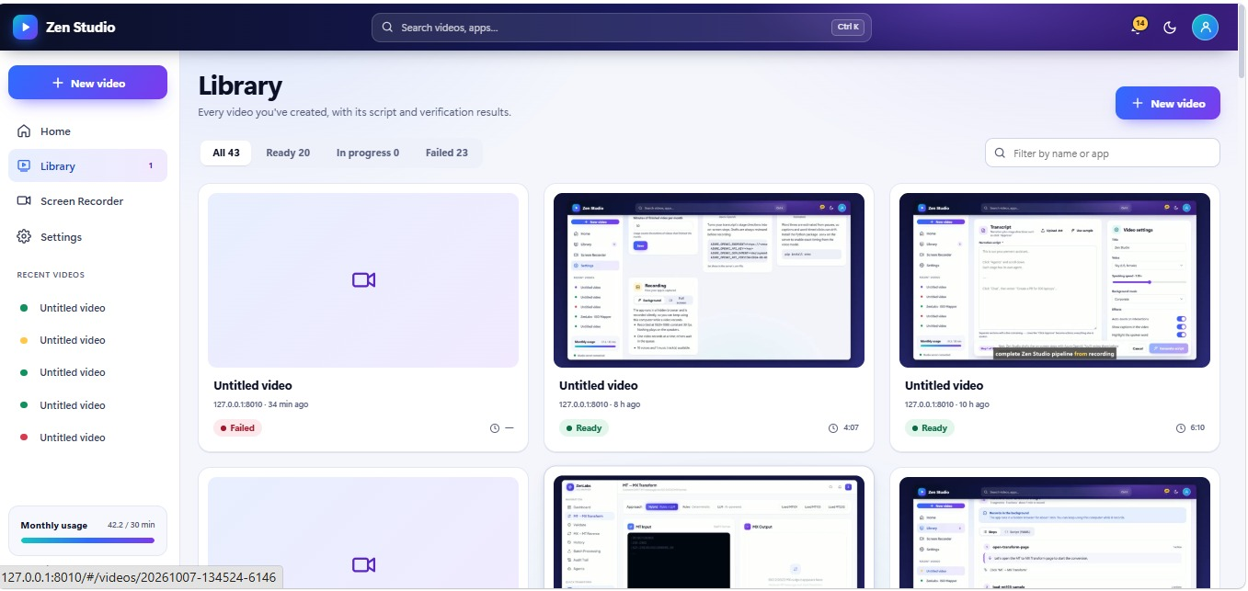
AT SCALE
Built for a library, not a one-off
Every video is tracked from draft to verified render — with real production metrics, not vanity ones.
Every video's full history, searchable in one library.
Zen Studio
12

Slide 13
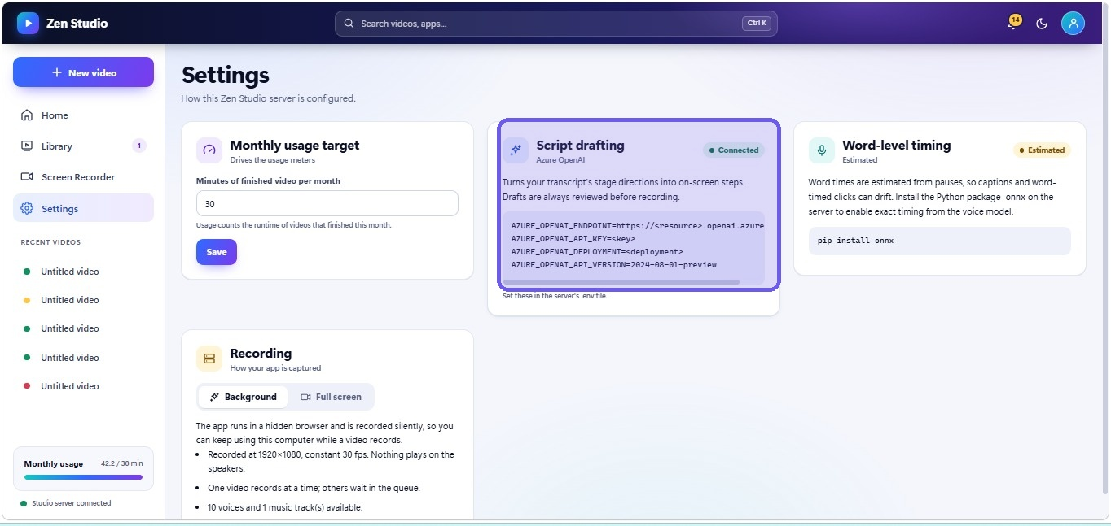
UNDER THE HOOD
Configurable, transparent,
production-ready
Your own Azure OpenAI deployment drives script drafting. Recording runs headless at a fixed 1920×1080 / 30fps, one job at a time, so every render is reproducible.
Zen Studio
13

Slide 14
ROADMAP
What's next
PPT to Video
Multi-page journeys
More voices & languages
Point Zen Studio at a slide deck instead of a URL — same narrated, verified pipeline, no browser required.
Chain several apps and hand-offs into one continuous narrated demo.
Expand beyond today's ten voices for a global audience.
Zen Studio
14

Slide 15
Turn any script
into a demo.
Zen Studio — AI-powered demo creation from any transcript

